Slide 1

MID PRESENTATION SSD PROJECT
COLOUR BLINDNESS DETECTION USING A-Frame
Notes:
video youube link + ppt explnation video
13

Slide 2
INTRODUCTION
Team Number SSD13
Sai Sirisha Nadiminti
Devershi Chandra
Pawan Patidar
Vishal Patel
Notes:
Group members names - Colour blindness detection using Aframe

Slide 3
PROBLEM DESCRIPTION
Notes:
problem solving
Colour blindness, types

Slide 4
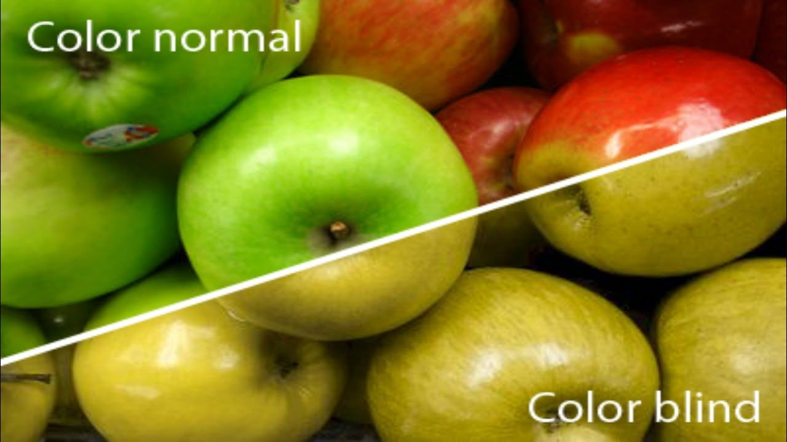
COLOUR BLINDNESS
Notes:
Mark Zuckerberg
13

Slide 5
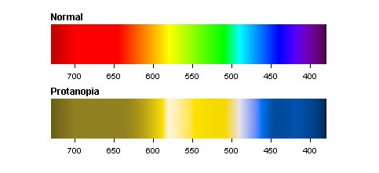
PROTANOPIA
Notes:
13

Slide 6
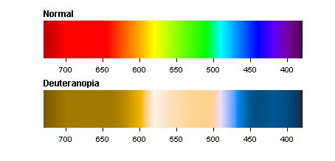
DEUTERANOPIA
Notes:
13

Slide 7
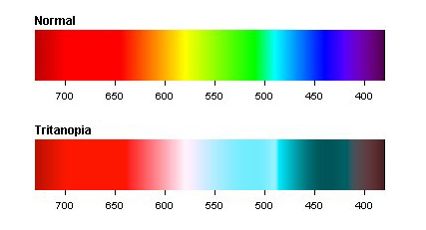
TRITANOPIA
Notes:
13

Slide 8
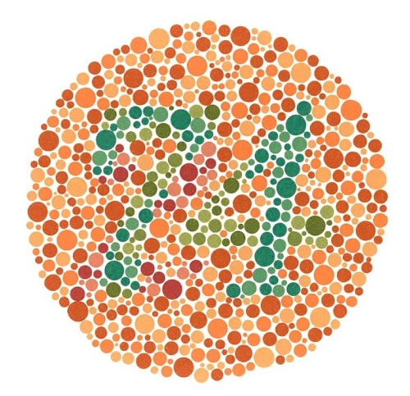
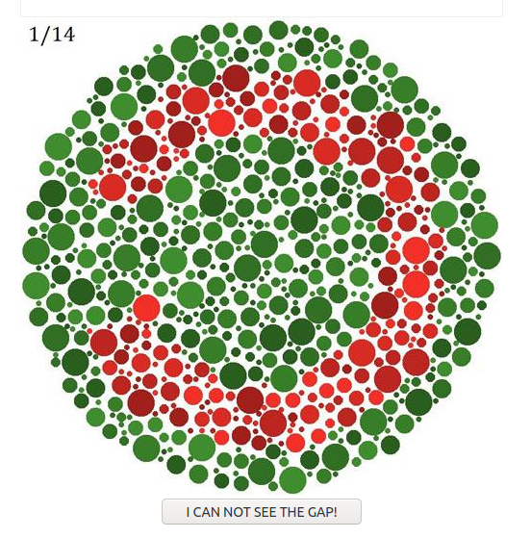
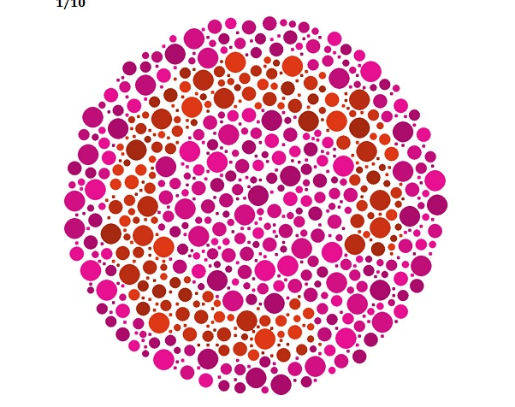
ALTERNATIVE SOLUTIONS
Notes:
13

Slide 9
SOLUTION APPROACH
Exact type of colour blindness
Score system
Better user experience
More interactive
Notes:
Based on the perception of the user towards colours. Is he able to distinguish between the colours? Using aframe - better user experience, more interactive

Slide 10


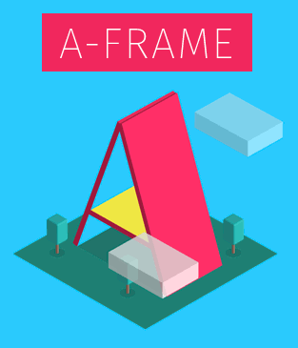
TECHNICAL DETAILS
Notes:
AFrame library
HTML Javascript

Slide 11
DEMO
Gihub repository link
YouTube video link for Project Demo
YouTube video link for PPT Explanation

Slide 12
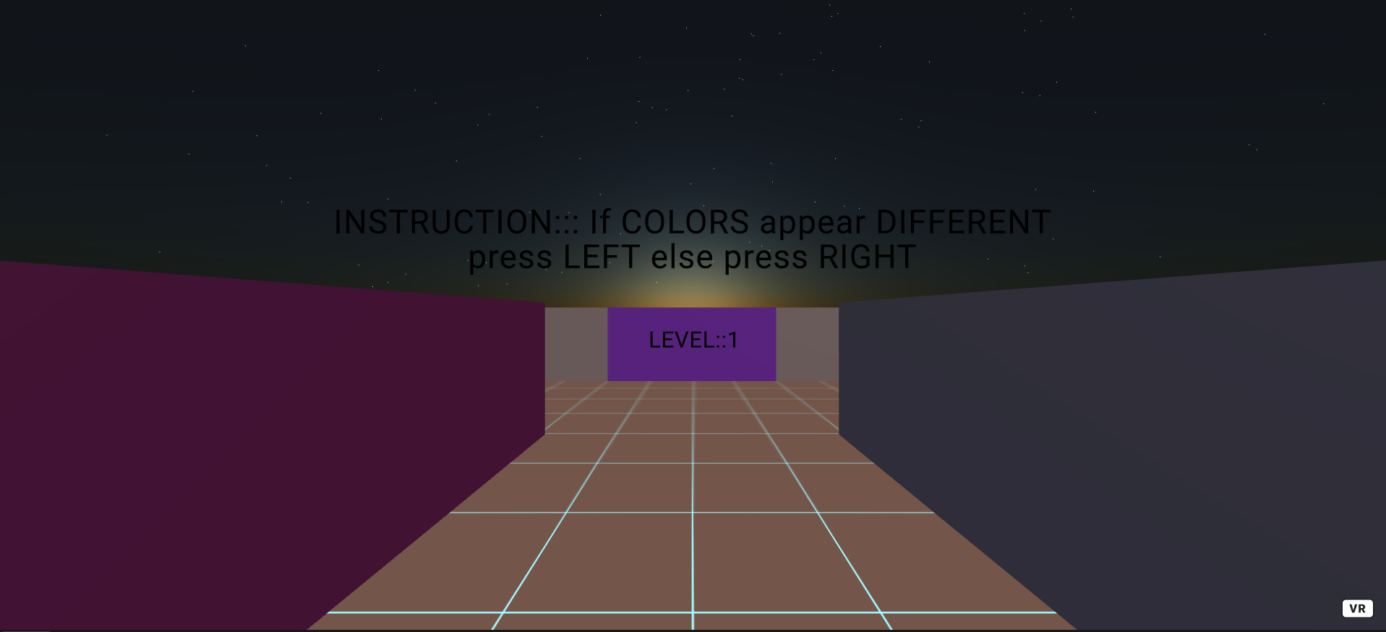
Notes:
13

Slide 13
WORK DISTRIBUTION

Slide 14
1. Research about problem statement - Sai Sirisha 2. Designed and built basic architecture of maze - Devershi Chandra 3. Started static build for protanopia - Devershi Chandra 4. Started static build for deuteranopia - Vishal Patel 5. Colliders for static walls - Sai Sirisha 6. Dynamic wall creation using js for deuteranopia – Pawan Patidar 7. Dynamic walls environment and audio for game - Devershi Chandra 8. Colliders for dynamic walls - Sai Sirisha
Notes:
13

Slide 15
FURTHER TIMELINE
Notes:
13

Slide 16
1. Give the user options to restart the game and select another test 2. Extend the same maze to protanopia and tritanopia 3. Improve UI for better user experience
Notes:
<number>

Slide 17
REFERENCES
[1] ​ https://www.colorlitelens.com/color-blindness-test.html
[2] ​ https://www.color-blindness.com/types-of-color-blindness/
[3] ​ Maciej Laskowski, Using 2D and 3D Computer Gamesto Detect Colorblindness –a Comparative Study
[4] ​ https://venngage.com/blog/color-blind-friendly-palette/
[5] ​ https://www.color-blindness.com/coblis-color-blindness-simulator/
Notes:
<number>

Slide 18
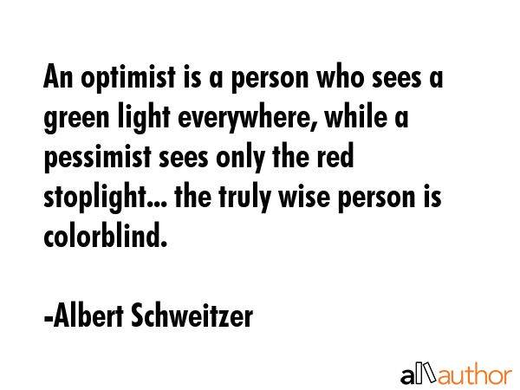
THANK YOU!
Notes:
<number>

